Slide 1
Analysis of massive data sets
http://www.fer.hr/predmet/avsp
Prof. dr. sc. Siniša Srbljić
Doc. dr. sc. Dejan Škvorc
Doc. dr. sc. Ante Đerek
Faculty of Electrical Engineering and Computing
Consumer Computing Laboratory

Slide 2
Analysis of Massive Data Sets:
Mining Large Graphs – Link Analysis
Marin Šilić

Slide 3
Overview
Motivation
Link Analysis
Flow Formulation
Matrix Formulation
Power Iteration Method
Google Formulation
Implementation Details

Slide 4
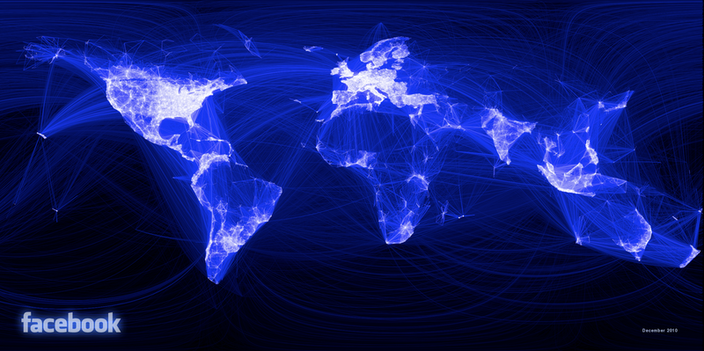
Motivation
Data Naturally Represented as Graph
  Social Networks
Facebook's Social Network Graph: Paul Butler, intern at Facebook,
Visualization of the locality of friendship, 2010

Slide 5
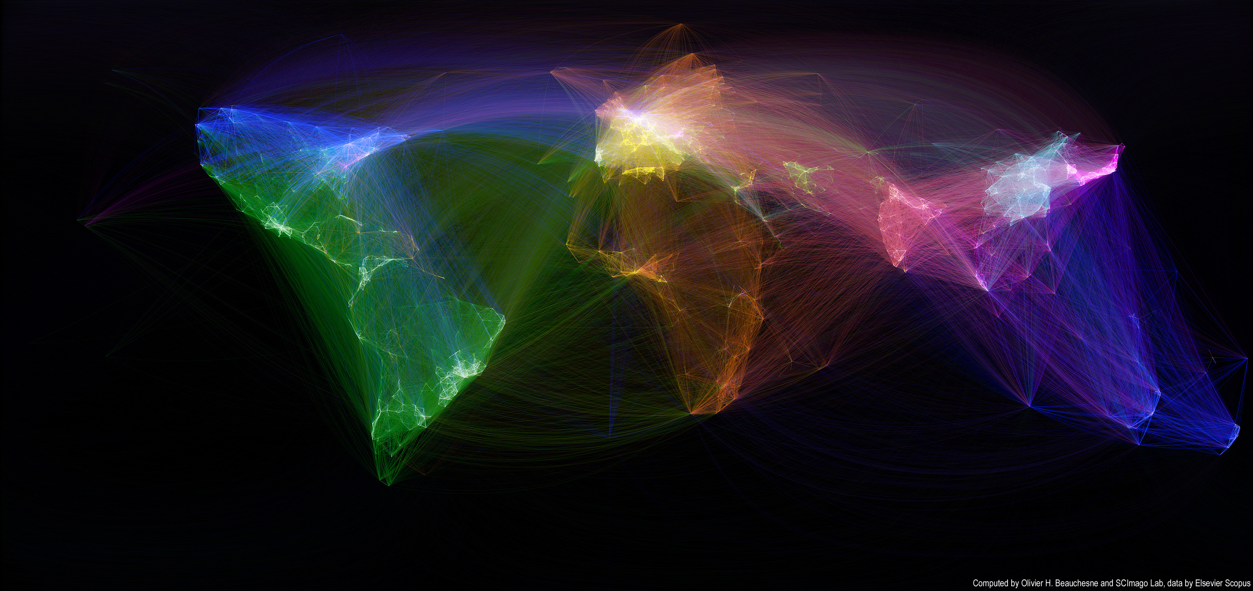
Motivation
Data Naturally Represented as Graph
  Map of scientific collaboration
http://olihb.com/2011/01/23/map-of-scientific-collaboration-between-researchers/

Slide 6
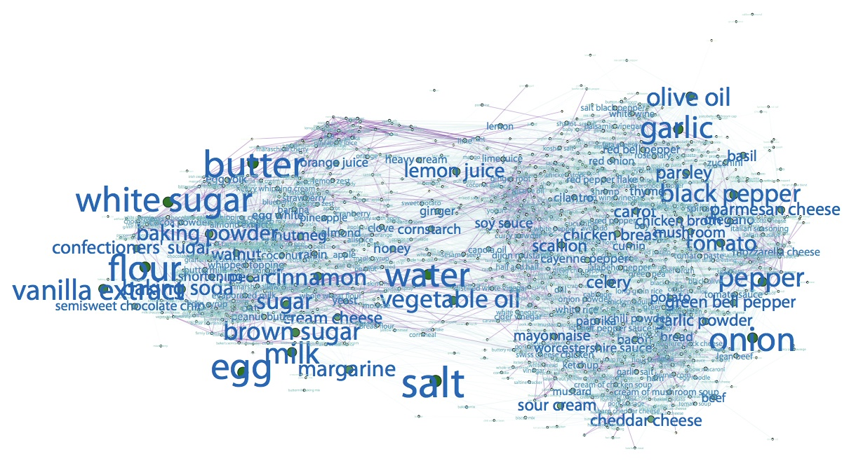
Motivation
Data Naturally Represented as Graph
  Ingredient networks
Teng, Chun-Yuen, Yu-Ru Lin, and Lada A. Adamic.
"Recipe recommendation using ingredient networks."
Proceedings of the 4th Annual ACM Web Science Conference. ACM, 2012.

Slide 7
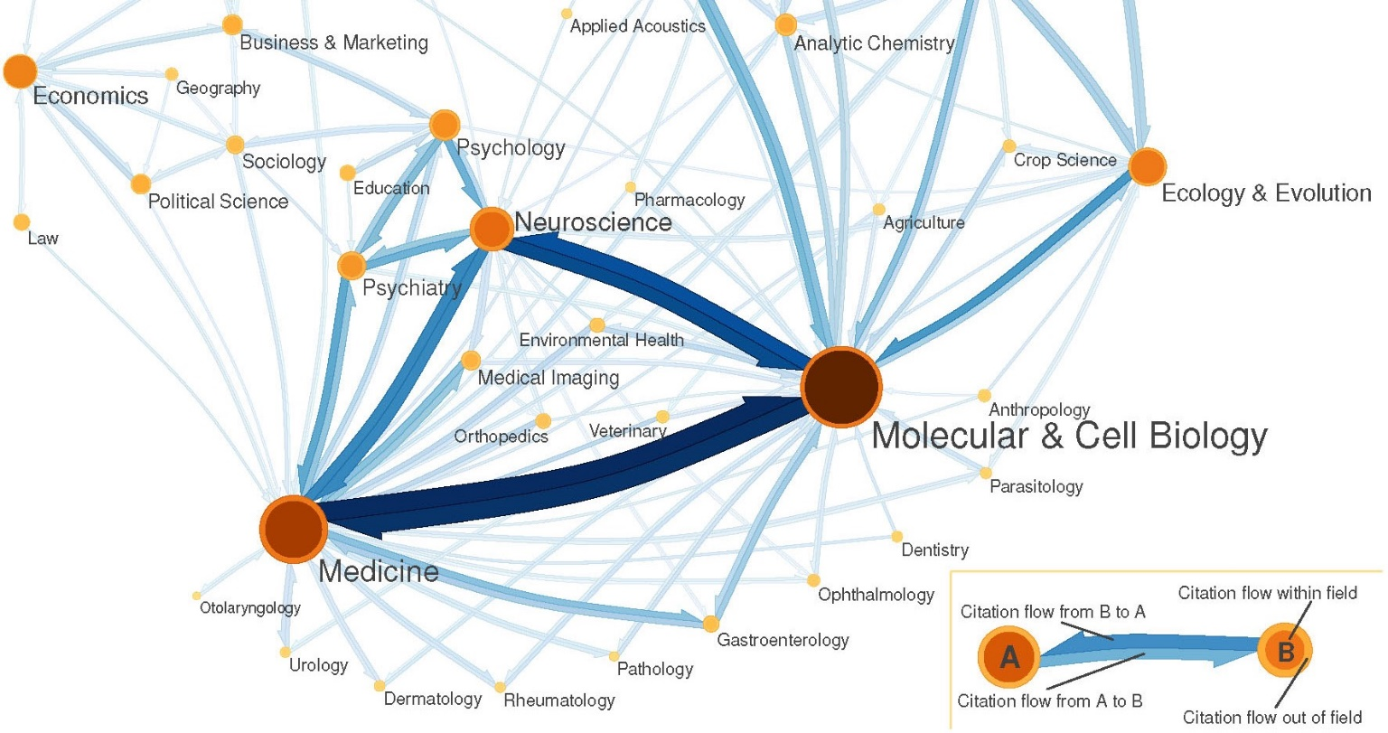
Motivation
Data Naturally Represented as Graph
  The science citation map
West, Jevin D. Eigenfactor: ranking and mapping scientific knowledge. Diss.
University of Washington, 2010.

Slide 8
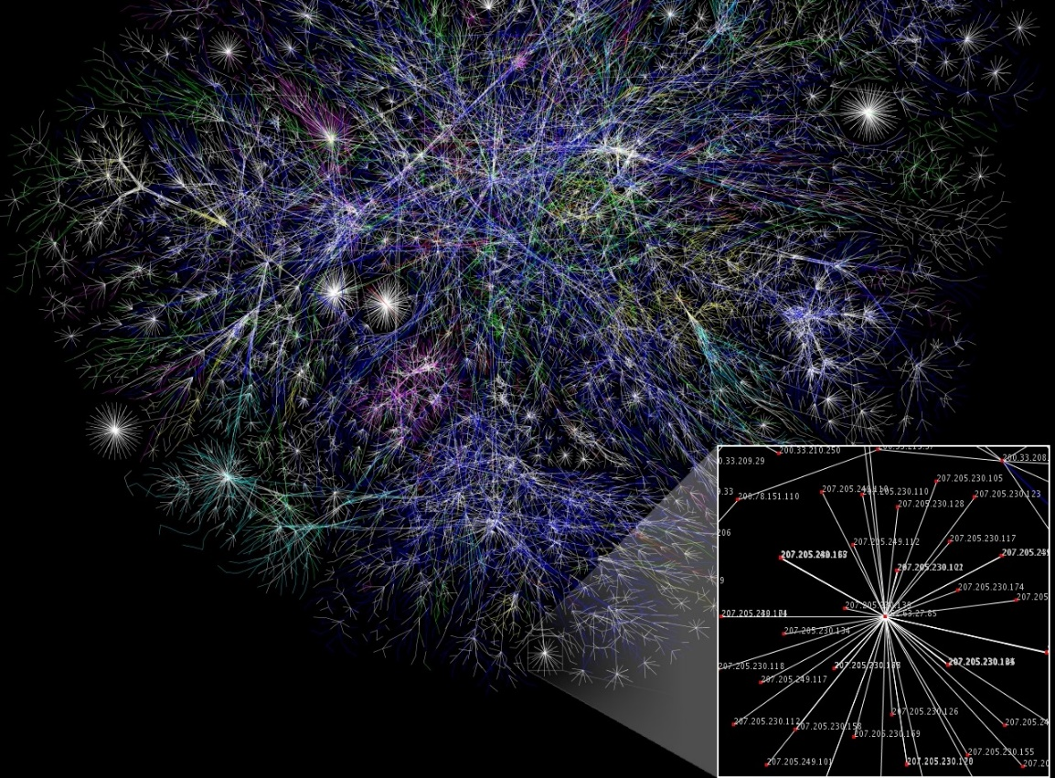
Motivation
Data Naturally Represented as Graph
  The map of Internet in 2005 (Wikipedia)
Partial map of the Internet based on the January 15, 2005 data found on opte.org.
Each line is drawn between two nodes, representing two IP addresses.

Slide 9
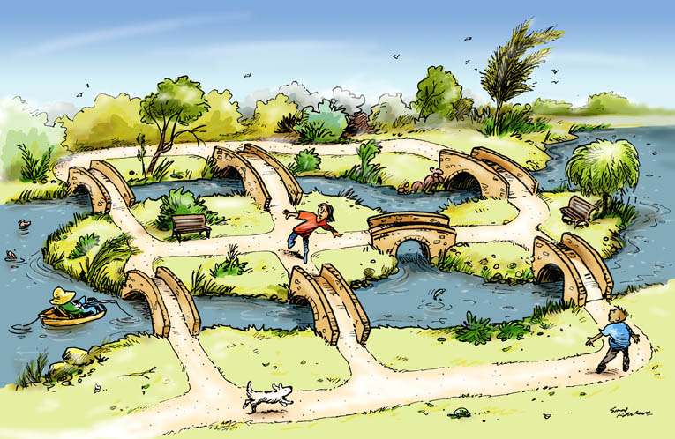
Motivation
Data Naturally Represented as Graph
  Topological networks
    Power supply network, water supply network, transportation…
    Seven bridges of Konigsberg (Euler’s path) puzzle.
Is Euler’s path is possible?
The answer is NO.
It depends on the degrees of nodes.
The graph should have exactly zero
or two nodes with an odd degree.

Slide 10
Link Analysis
Imagine the Web as a Graph
  Directed graph
    Nodes: Websites
    Edges: Link among websites – Hyperlinks
AVSP
site
ZEMRIS
site
FER
site
UNIZG
site

Slide 11
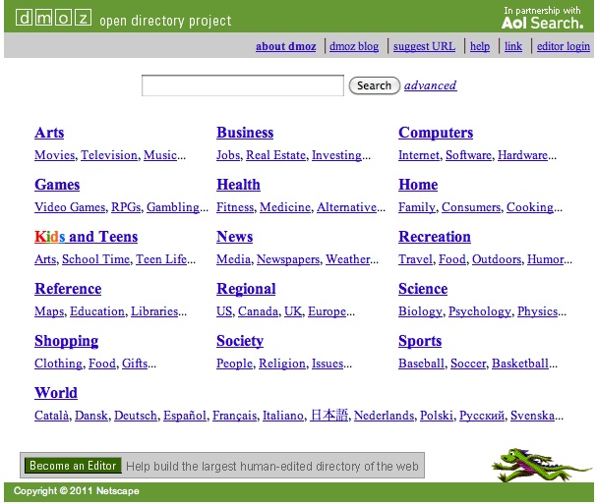
Link Analysis
How to organize the Web?
  First try: Human organized
    Web directories
      Yahoo, DMOZ, LookSmart
    Put each new website in its category
    Issue: Web is huge, the approach
    does not scale!!
  Second try: Web Search
    Information Retrieval
      Find relevant docs in a small and trusted subset
      Newspapers articles and similar trusted data corpus
    Issue: Again, web is huge, plenty of untrusted documents, random things, web spam, etc.

Slide 12
Link Analysis
Two main challenges of Web Search
  There are plenty of information sources on the web
  Who do we trust?
    Idea: Use structure of the web graphs
    Trusted pages are likely to point to each other!
  What is the best (appropriate) answer to query
  “media”
    There is an ambiguity in this query, no single right answer
    Idea: Again, utilize structure of the web
    The pages that actually know about media might all be pointing to many media sites

Slide 13
Link Analysis
Ranking Nodes on the Graph
  All web pages are not equally important
    www.johndoe.com
    www.fer.hr
  The structure of the web graph tells something
    There is a large diversity when considering node
    connectivity
    The idea: Lets rank pages by the link structure
    The green node is more important
    than the red node

Slide 14
Link Analysis
Link Analysis Algorithms
  Computing the importance of the nodes in the graph
  Various solutions to the Link Analysis problem
    Page Rank
    Topic-Specific (Personalized) Page Rank
    Web Spam Detection Algorithms

Slide 15
Flow Formulation
Count Node’s Links
  Idea: Utilize graph structure
  Count node links as votes
    Incoming links vs Outgoing links
  Imagine incoming links as votes
    www.fer.hr has 24622 incoming links
    www.johndoe.com has 0 incoming links
  However, all incoming links are not equally important
    Links originating from important pages are worth more
    The nature of the problem is recursive

Slide 16
Flow Formulation
Graph Example: PageRank Scores
C
34.3
B
38.4
A
3.3
E
8.1
F
3.9
D
3.9
1.6
1.6
1.6
1.6
1.6

Slide 17
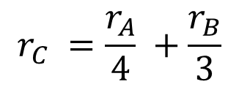


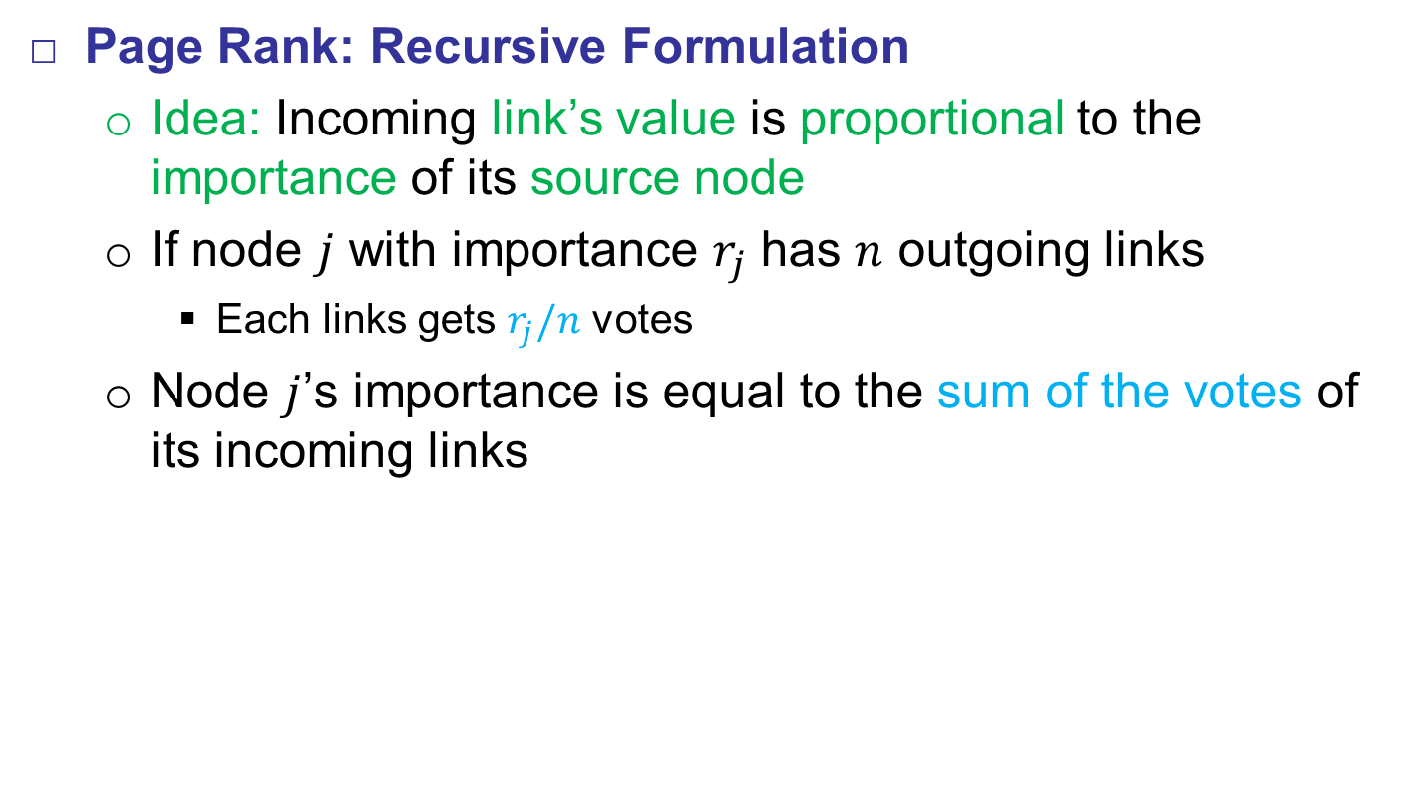
Flow Formulation
Page Rank: Recursive Formulation
  Idea: Incoming link’s value is proportional to the importance of its source node
  If node $j$ with importance $r_{j}$ has $n$ outgoing links
    Each links gets $r_{j}/n$ votes
  Node $j$’s importance is equal to the sum of the votes of its incoming links
B
A
$$r_{C} =\frac{r_{A}}{4} +\frac{r_{B}}{3}$$
$$r_{A}/4$$
$$r_{B}/3$$
C

Slide 18


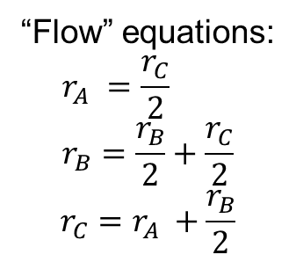

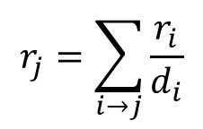
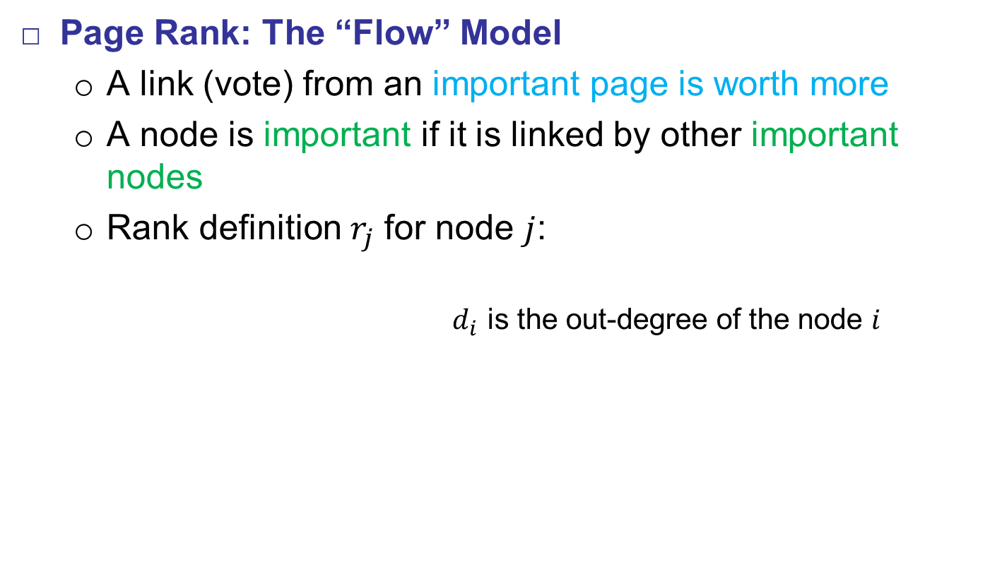


Flow Formulation
Page Rank: The “Flow” Model
  A link (vote) from an important page is worth more
  A node is important if it is linked by other important nodes
  Rank definition $r_{j}$ for node $j$:
    $d_{i}$ is the out-degree of the node $i$
$$r_{j}=\sum_{i→j}{\frac{r_{i}}{d_{i}}}$$
“Flow” equations:
$$r_{A} =\frac{r_{C}}{2} \\ r_{B}=\frac{r_{B}}{2}+\frac{r_{C}}{2}$$
$$r_{C}=r_{A} +\frac{r_{B}}{2}$$
$$r_{B}/2$$
A
$$r_{C}/2$$
$$r_{C}/2$$
B
$$r_{A}$$
$$r_{B}/2$$
C

Slide 19
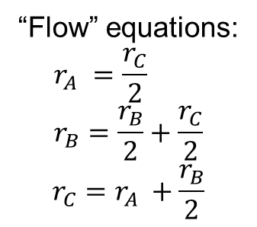
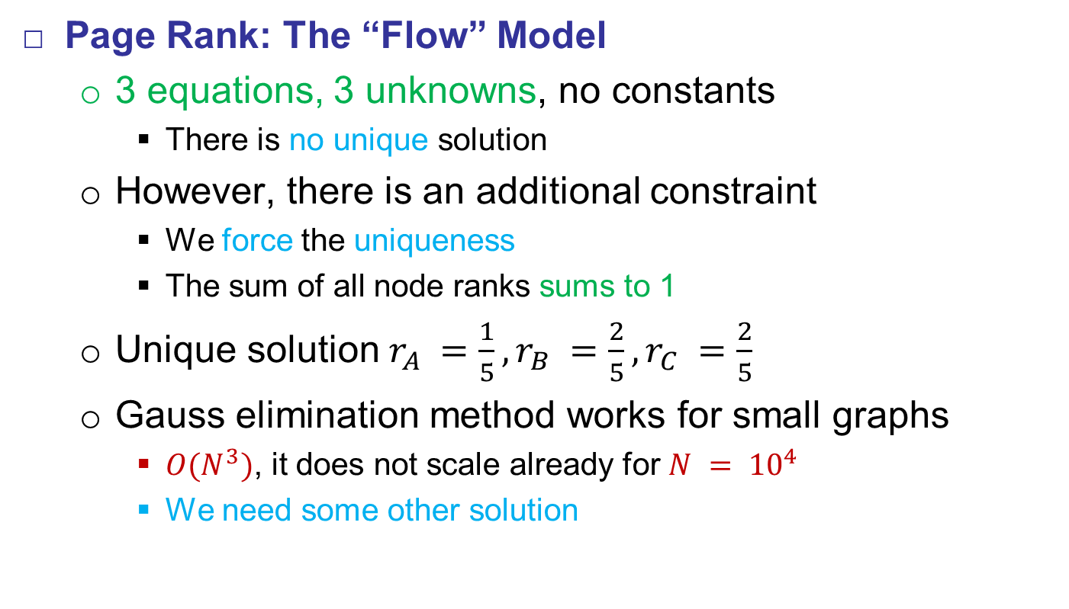
Flow Formulation
Page Rank: The “Flow” Model
  3 equations, 3 unknowns, no constants
    There is no unique solution
  However, there is an additional constraint
    We force the uniqueness
    The sum of all node ranks sums to 1
  Unique solution $r_{A} =\frac{1}{5}, r_{B} =\frac{2}{5}, r_{C} =\frac{2}{5}$
  Gauss elimination method works for small graphs
    $O(N^{3})$, it does not scale already for $N = {10}^{4}$
    We need some other solution
“Flow” equations:
$$r_{A} =\frac{r_{C}}{2} \\ r_{B}=\frac{r_{B}}{2}+\frac{r_{C}}{2}$$
$$r_{C}=r_{A} +\frac{r_{B}}{2}$$

Slide 20

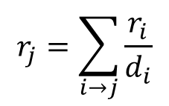
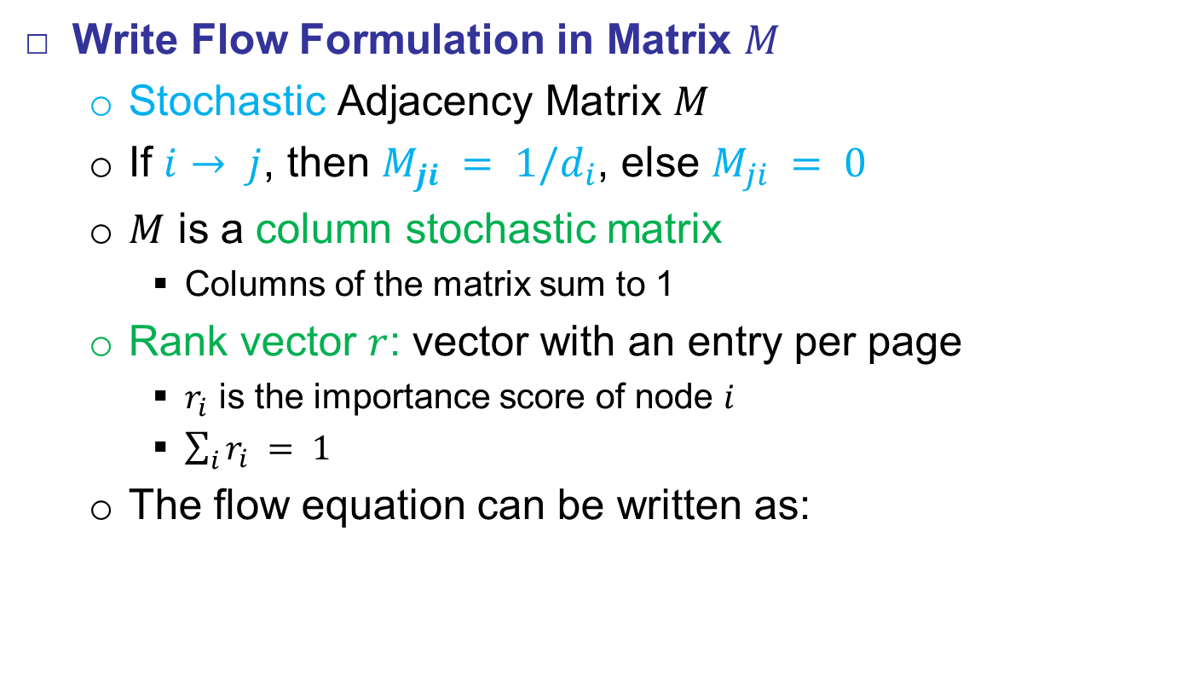
Matrix Formulation
Write Flow Formulation in Matrix $M$
  Stochastic Adjacency Matrix $M$
  If $i→ j$, then $M_{ji} = 1/d_{i}$, else $M_{ji} = 0$
  $M$ is a column stochastic matrix
    Columns of the matrix sum to 1
  Rank vector $r$: vector with an entry per page
    $r_{i}$ is the importance score of node $i$
    $\sum_{i}{r_{i}} = 1$
  The flow equation can be written as:
$$r_{j}=\sum_{i→j}{\frac{r_{i}}{d_{i}}}$$
$$r=M∙r$$

Slide 21


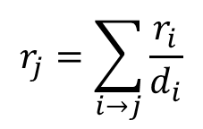



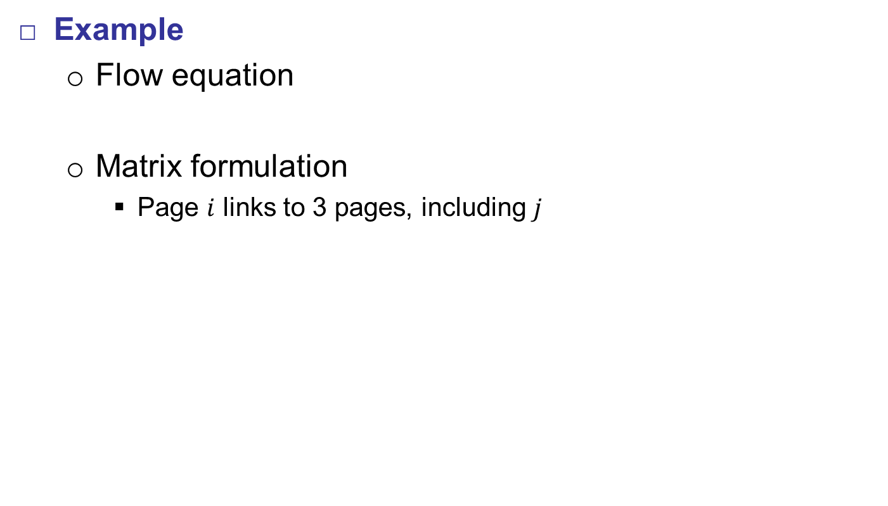




Matrix Formulation
Example
  Flow equation
  Matrix formulation
    Page $i$ links to 3 pages, including $j$
$$r_{j}=\sum_{i→j}{\frac{r_{i}}{d_{i}}}$$
$$M∙r=r$$
$$i$$
$$j$$
$$r_{j}$$
$$∙$$
$$=$$
$$r_{i}$$
$$\frac{r_{i}}{3}$$
$$M ∙ r = r$$

Slide 22


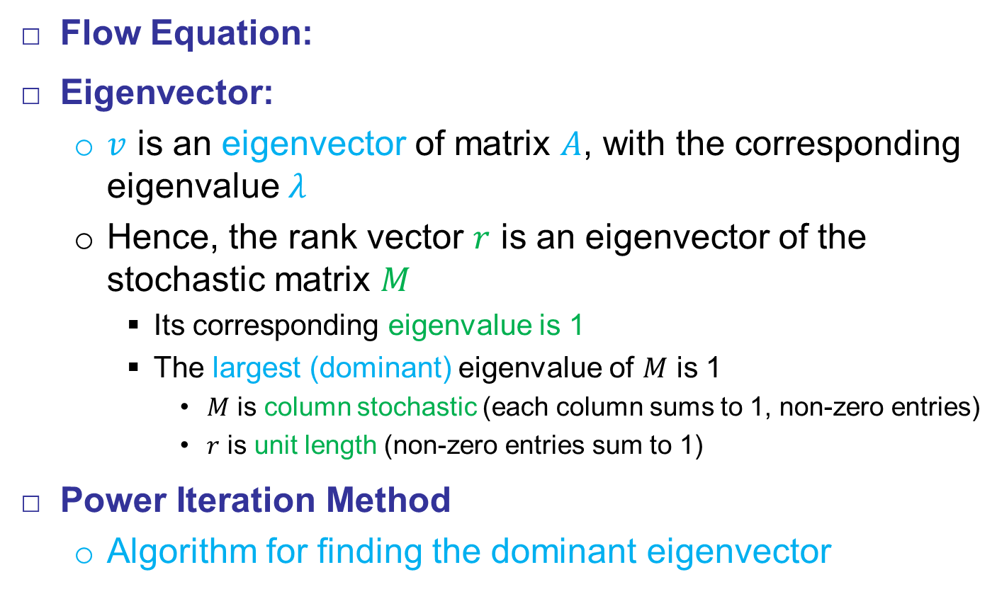
Matrix Formulation
$$M∙r=r$$
Flow Equation:
Eigenvector:
  $v$ is an eigenvector of matrix $A$, with the corresponding eigenvalue $λ$
  Hence, the rank vector $r$ is an eigenvector of the stochastic matrix $M$
    Its corresponding eigenvalue is 1
    The largest (dominant) eigenvalue of $M$ is 1
      $M$ is column stochastic (each column sums to 1, non-zero entries)
      $r$ is unit length (non-zero entries sum to 1)
Power Iteration Method
  Algorithm for finding the dominant eigenvector
$$A∙v=λ∙v$$

Slide 23
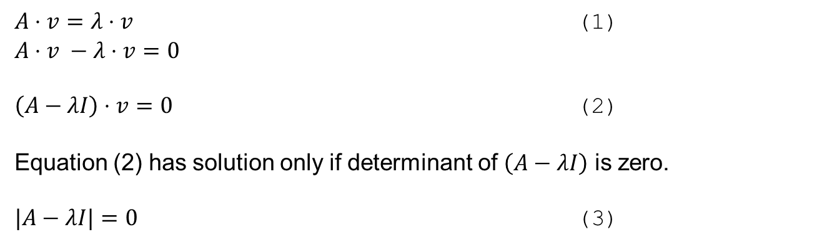




Matrix Formulation
Matrix Eigenvalues
$A⋅v=λ⋅v$ (1)
$A⋅v −λ⋅v=0$
$\left(A−λI\right)⋅v=0$ (2)
Equation (2) has solution only if determinant of $\left(A−λI\right)$ is zero.
$|A−λI|=0$ (3)
$A= \left[\begin{matrix}2 & 1 \\ 1 & 2\end{matrix}\right]$, $(A−λI)= \left[\begin{matrix}2 −λ & 1 \\ 1 & 2 − λ\end{matrix}\right]$
$\left|A−λI\right|=λ^{2} −4 λ+3, λ_{1}=1$ and $λ_{2}=3$
$$v_{λ=1}= \left[\begin{matrix}1 \\ −1\end{matrix}\right]$$
$$v_{λ=3}= \left[\begin{matrix}1 \\ 1\end{matrix}\right]$$

Slide 24
































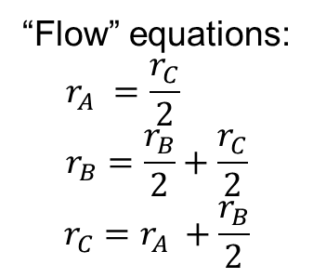











Matrix Formulation
Back to our Example…
$$r_{B}/2$$
“Flow” equations:
$$r_{A} =\frac{r_{C}}{2} \\ r_{B}=\frac{r_{B}}{2}+\frac{r_{C}}{2}$$
$$r_{C}=r_{A} +\frac{r_{B}}{2}$$
A
$$r_{C}/2$$
$$r_{C}/2$$
B
$$r_{A}$$
$$r_{B}/2$$
C
$$A$$
$$B$$
$$C$$
$$A$$
$$0$$
$$0$$
$$1/2$$
$$r_{A}$$
$$0$$
$$0$$
$$1/2$$
$$r_{A}$$
$$B$$
$$0$$
$$1/2$$
$$1/2$$
$$r_{B}$$
$$=$$
$$0$$
$$1/2$$
$$1/2$$
$$∙$$
$$r_{B}$$
$$C$$
$$1$$
$$1/2$$
$$0$$
$$r_{C}$$
$$1$$
$$1/2$$
$$0$$
$$r_{C}$$
$$M$$
$$r$$
$$=$$
$$M$$
$$∙$$
$$r$$

Slide 25
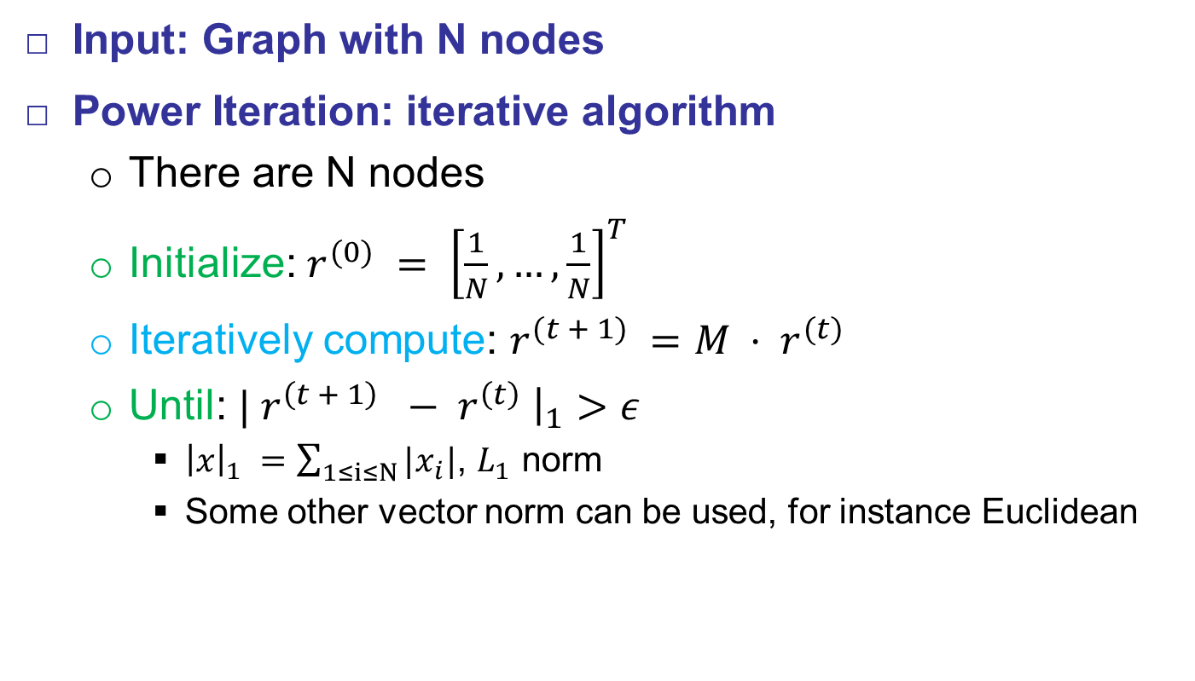
Power Iteration Method
Input: Graph with N nodes
Power Iteration: iterative algorithm
  There are N nodes
  Initialize: $r^{(0)} = {\left[\frac{1}{N}, …,\frac{1}{N}\right]}^{T}$
  Iteratively compute: $r^{(t + 1)} =M ⋅ r^{(t)}$
  Until: $| r^{\left(t + 1\right)} − r^{\left(t\right)} {\left.​\right|}_{1}>ε$
    ${\left|x\right|}_{1} =\sum_{1≤i≤N}{|x_{i}|}$, $L_{1}$ norm
    Some other vector norm can be used, for instance Euclidean

Slide 26




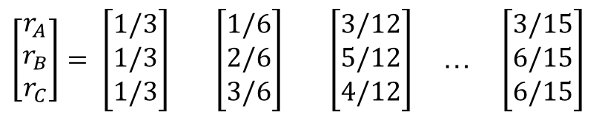
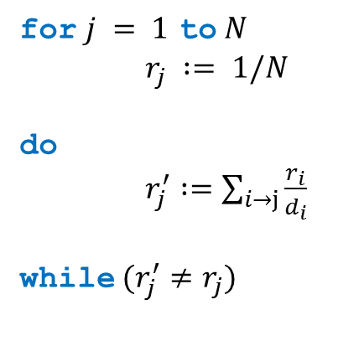
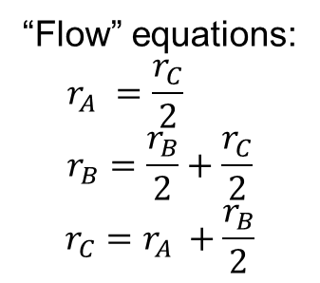

Power Iteration Method
Power Iteration Example
  Algorithm
  Results:
$$r_{B}/2$$
“Flow” equations:
$$r_{A} =\frac{r_{C}}{2} \\ r_{B}=\frac{r_{B}}{2}+\frac{r_{C}}{2}$$
$$r_{C}=r_{A} +\frac{r_{B}}{2}$$
for $j = 1$ to $N$
$r_{j} := 1/N$
do
$r_{j}^{′} :=\sum_{i→j}{\frac{r_{i}}{d_{i}}}$
while $(r_{j}^{′}≠r_{j})$
A
$$r_{C}/2$$
B
$$r_{C}/2$$
$$r_{A}$$
$$r_{B}/2$$
C
$\left[\begin{aligned}r_{A} \\ r_{B} \\ r_{C}\end{aligned}\right]= \left[\begin{aligned}1/3 \\ 1/3 \\ 1/3\end{aligned}\right]$ $\left[\begin{aligned}1/6 \\ 2/6 \\ 3/6\end{aligned}\right]$ $\left[\begin{aligned}3/12 \\ 5/12 \\ 4/12\end{aligned}\right]$ … $\left[\begin{aligned}3/15 \\ 6/15 \\ 6/15\end{aligned}\right]$
Iteration
0
1
2
…

Slide 27
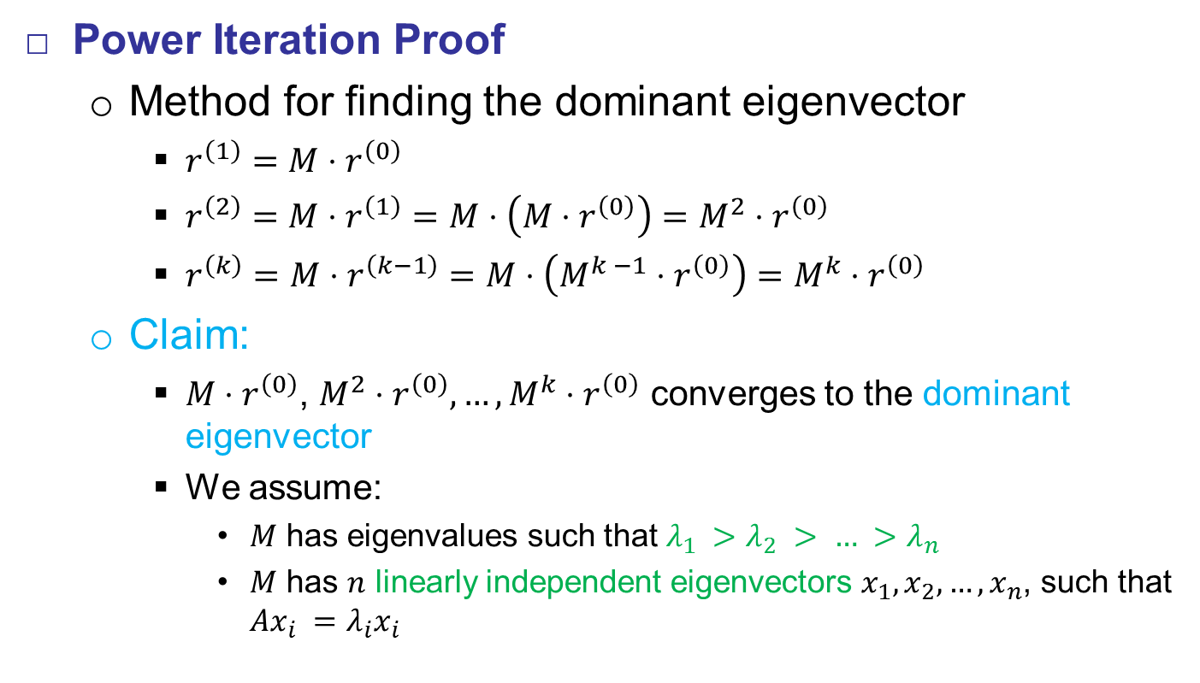
Power Iteration Method
Power Iteration Proof
  Method for finding the dominant eigenvector
    $r^{\left(1\right)}=M⋅r^{\left(0\right)}$
    $r^{\left(2\right)}=M⋅r^{\left(1\right)}=M⋅\left(M⋅r^{\left(0\right)}\right)=M^{2}⋅r^{\left(0\right)}$
    $r^{\left(k\right)}=M⋅r^{\left(k−1\right)}=M⋅\left(M^{k −1}⋅r^{\left(0\right)}\right)=M^{k}⋅r^{\left(0\right)}$
  Claim:
    $M⋅r^{\left(0\right)}$, $M^{2}⋅r^{\left(0\right)},…, M^{k}⋅r^{\left(0\right)}$ converges to the dominant
    eigenvector
    We assume:
      $M$ has eigenvalues such that $λ_{1} >λ_{2} > … >λ_{n}$
      $M$ has $n$ linearly independent eigenvectors $x_{1}, x_{2}, …, x_{n}$, such that $Ax_{i} =λ_{i}x_{i}$

Slide 28
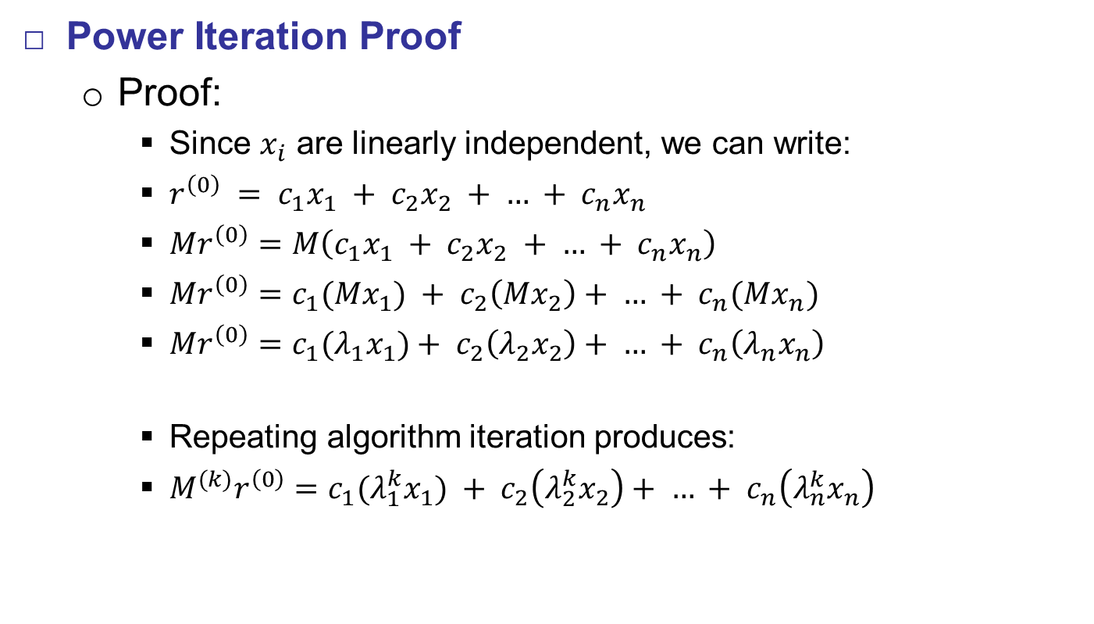
Power Iteration Method
Power Iteration Proof
  Proof:
    Since $x_{i}$ are linearly independent, we can write:
    $r^{\left(0\right)} = c_{1}x_{1} + c_{2}x_{2} + … + c_{n}x_{n}$
    $Mr^{\left(0\right)}=M\left(c_{1}x_{1} + c_{2}x_{2} + … + c_{n}x_{n}\right)$
    $Mr^{\left(0\right)}=c_{1}{(Mx}_{1}) + c_{2}\left(Mx_{2}\right)+ … + c_{n}(Mx_{n})$
    $Mr^{\left(0\right)}=c_{1}{(λ_{1}x}_{1})+ c_{2}\left(λ_{2}x_{2}\right)+ … + c_{n}\left(λ_{n}x_{n}\right)$
    Repeating algorithm iteration produces:
    $M^{(k)}r^{\left(0\right)}=c_{1}{(λ_{1}^{k}x}_{1}) + c_{2}\left(λ_{2}^{k}x_{2}\right)+ … + c_{n}\left(λ_{n}^{k}x_{n}\right)$

Slide 29
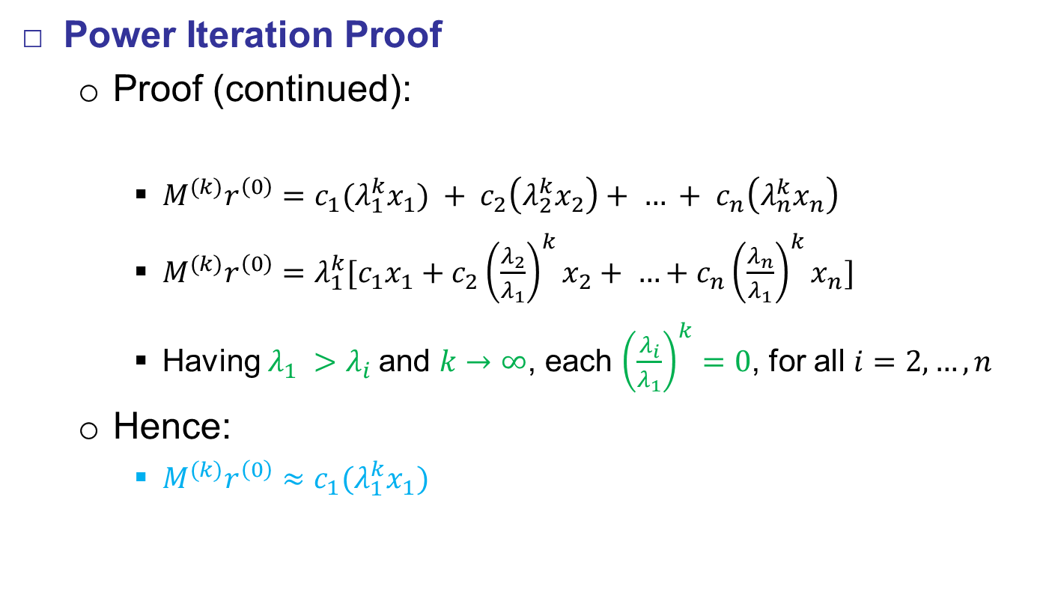
Power Iteration Method
Power Iteration Proof
  Proof (continued):
    $M^{(k)}r^{\left(0\right)}=c_{1}{(λ_{1}^{k}x}_{1}) + c_{2}\left(λ_{2}^{k}x_{2}\right)+ … + c_{n}\left(λ_{n}^{k}x_{n}\right)$
    $M^{(k)}r^{\left(0\right)}=λ_{1}^{k}[c_{1}x_{1}+{c_{2}\left(\frac{λ_{2}}{λ_{1}}\right)}^{k}x_{2}+ …+{c_{n}\left(\frac{λ_{n}}{λ_{1}}\right)}^{k}x_{n}]$
    Having $λ_{1} >λ_{i}$and $k→∞$, each ${\left(\frac{λ_{i}}{λ_{1}}\right)}^{k}=0$, for all $i=2, …, n$
  Hence:
    $M^{(k)}r^{\left(0\right)}≈c_{1}(λ_{1}^{k}x_{1})$

Slide 30
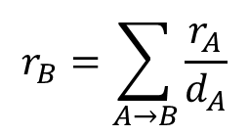
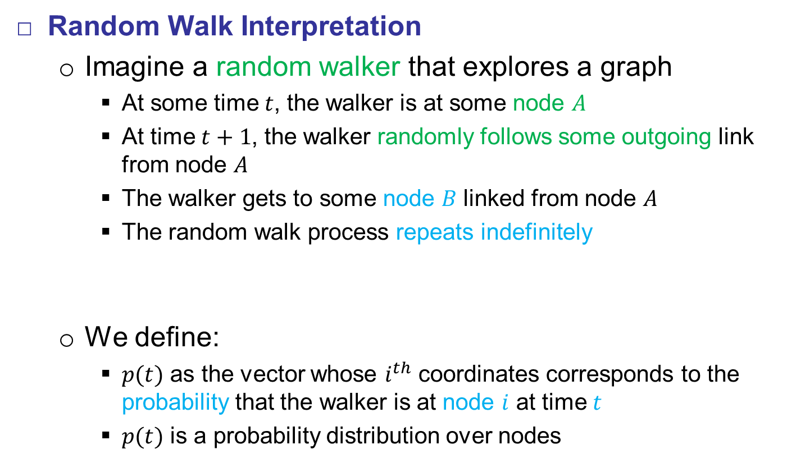
Power Iteration Method
Random Walk Interpretation
  Imagine a random walker that explores a graph
    At some time $t$, the walker is at some node $A$
    At time $t+1$, the walker randomly follows some outgoing link from node $A$
    The walker gets to some node $B$ linked from node $A$
    The random walk process repeats indefinitely
  We define:
    $p(t)$ as the vector whose $i^{th}$ coordinates corresponds to the probability that the walker is at node $i$ at time $t$
    $p(t)$ is a probability distribution over nodes
A₂
$$r_{B}=\sum_{A→B}{\frac{r_{A}}{d_{A}}}$$
A₃
A₁
B

Slide 31
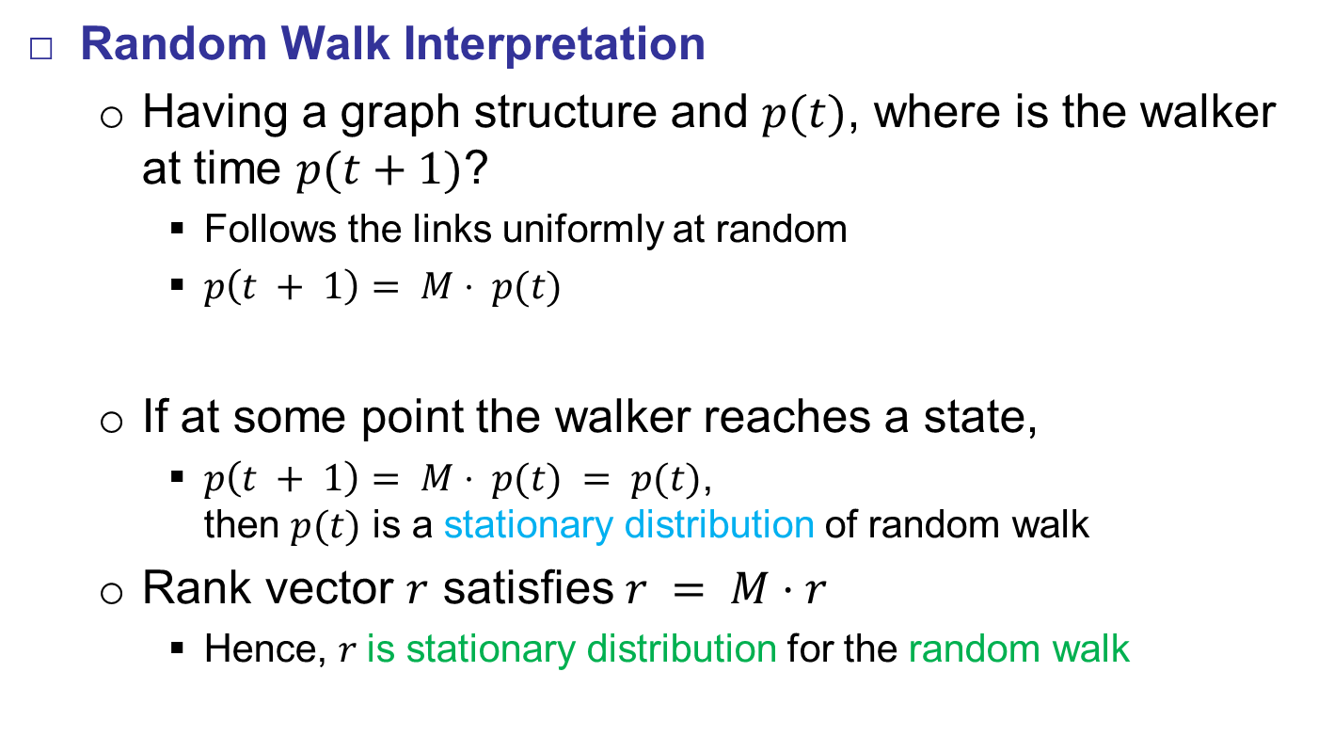
Power Iteration Method
Random Walk Interpretation
  Having a graph structure and $p(t)$, where is the walker at time $p(t+1)$?
    Follows the links uniformly at random
    $p\left(t + 1\right)= M⋅ p(t)$
  If at some point the walker reaches a state,
    $p\left(t + 1\right)= M⋅ p(t) = p(t)$,
    then $p(t)$ is a stationary distribution of random walk
  Rank vector $r$ satisfies $r = M⋅r$
    Hence, $r$is stationary distribution for the random walk
A₂
A₃
A₁
B

Slide 32
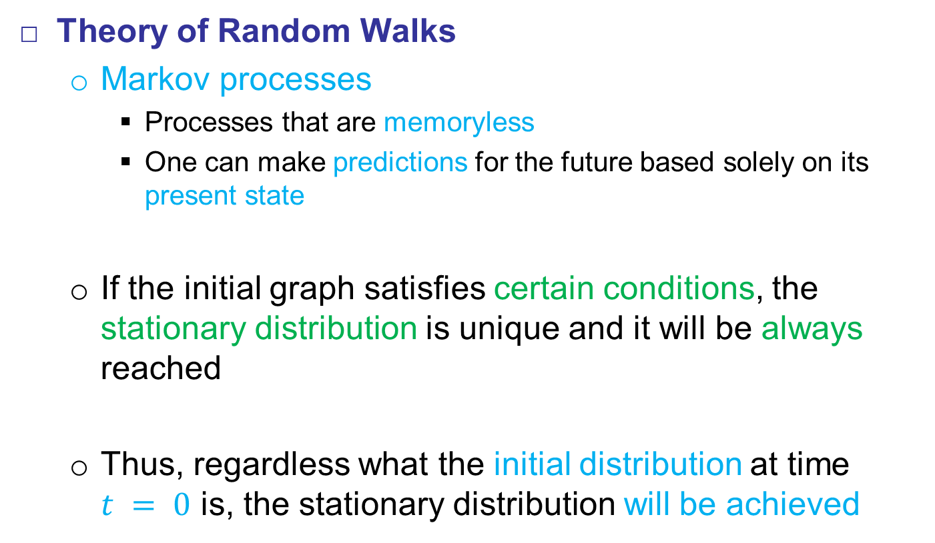
Power Iteration Method
Theory of Random Walks
  Markov processes
    Processes that are memoryless
    One can make predictions for the future based solely on its present state
  If the initial graph satisfies certain conditions, the stationary distribution is unique and it will be always reached
  Thus, regardless what the initial distribution at time
  $t = 0$ is, the stationary distribution will be achieved

Slide 33

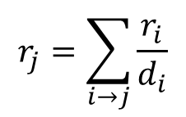
Google Formulation
So far:
  Flow equation:
  Matrix formulation:
  Two questions:
    Does it converge?
    Does the solution makes sense?
$$r_{j}=\sum_{i→j}{\frac{r_{i}}{d_{i}}}$$
$$r=M∙r$$

Slide 34
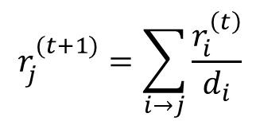
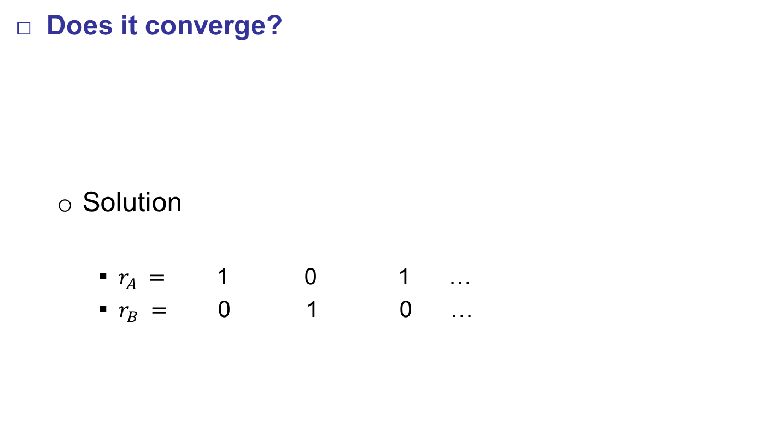
Google Formulation
Does it converge?
  Solution
    $r_{A} =$ 1 0 1 …
    $r_{B} =$ 0 1 0 …
$$r_{j}^{(t+1)}=\sum_{i→j}{\frac{r_{i}^{\left(t\right)}}{d_{i}}}$$
A
B
It will never converge!
Iteration
0
1
2
…

Slide 35
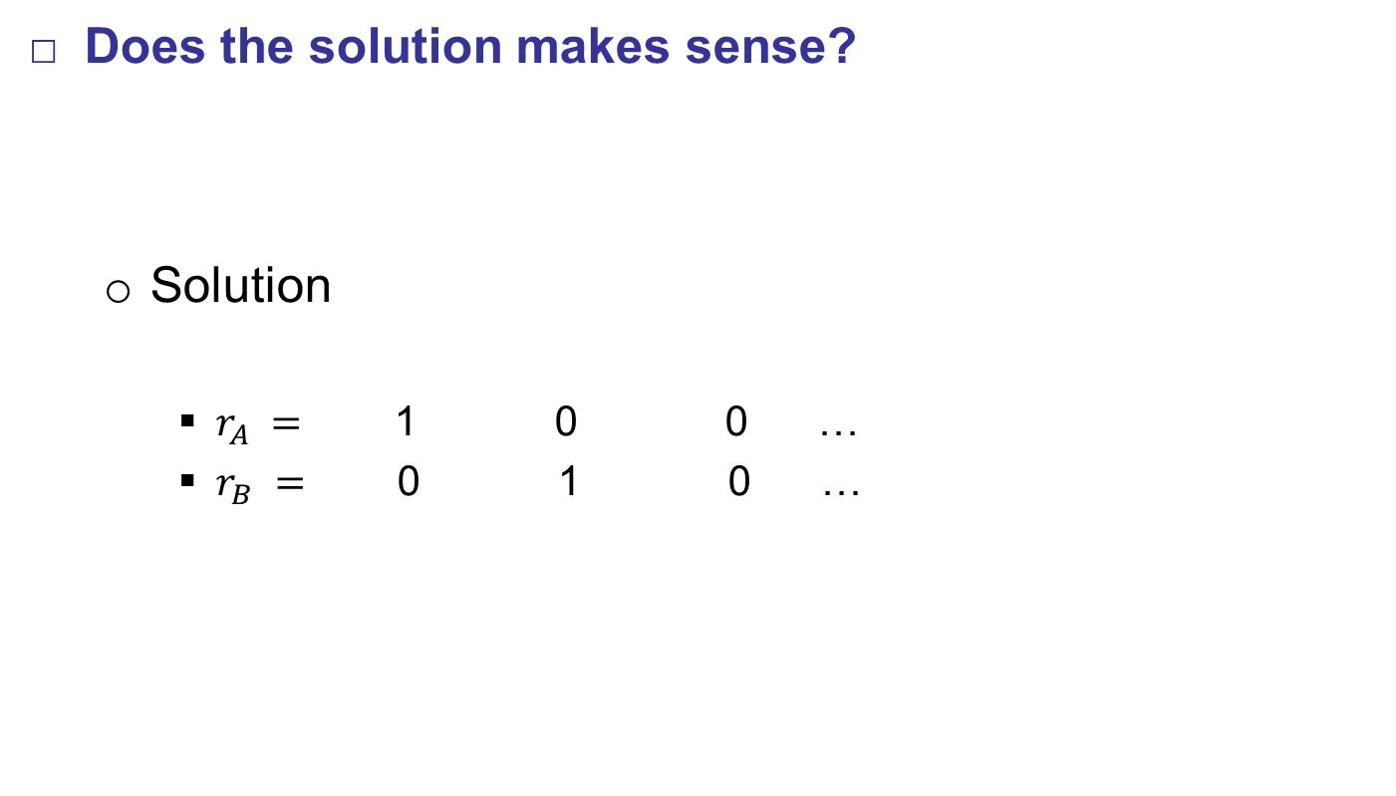
Google Formulation
Does the solution makes sense?
  Solution
    $r_{A} =$ 1 0 0 …
    $r_{B} =$ 0 1 0 …
$$r_{j}^{(t+1)}=\sum_{i→j}{\frac{r_{i}^{\left(t\right)}}{d_{i}}}$$
A
B
It will converge to a
meaningless result!
Iteration
0
1
2
…

Slide 36
Google Formulation
PageRank issues
  (1) Some nodes are dead ends
  without out links
    Random walker does not have a way to go
    The importance “leaks out” from such nodes
  (2) There exist spider traps:
  (all links are within the group)
    Random walker can not go out of the trap
    At some point spider traps absorb
    all the importance
A
B
C
Dead end
A
B
C
D
E
Spider trap

Slide 37










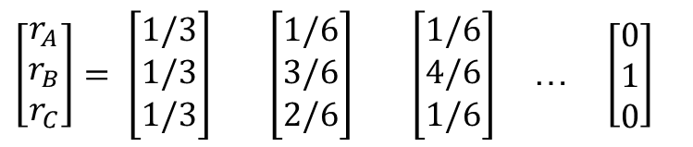







Google Formulation
Issue (2): Spider traps
  Power Iteration
  Results:
$$A$$
$$B$$
$$C$$
$$r_{B}$$
$$A$$
$$0$$
B
$$0$$
$$1/2$$
A
$$r_{C}/2$$
$$r_{C}/2$$
$$B$$
$$0$$
$$1$$
$$1/2$$
$$r_{A}$$
$$C$$
$$1$$
$$0$$
$$0$$
C
$$M$$
$\left[\begin{aligned}r_{A} \\ r_{B} \\ r_{C}\end{aligned}\right]= \left[\begin{aligned}1/3 \\ 1/3 \\ 1/3\end{aligned}\right]$ $\left[\begin{aligned}1/6 \\ 3/6 \\ 2/6\end{aligned}\right]$ $\left[\begin{aligned}1/6 \\ 4/6 \\ 1/6\end{aligned}\right]$ … $\left[\begin{aligned}0 \\ 1 \\ 0\end{aligned}\right]$
Iteration
0
1
2
…
B is a spider trap, all the importance gets trapped in node B

Slide 38




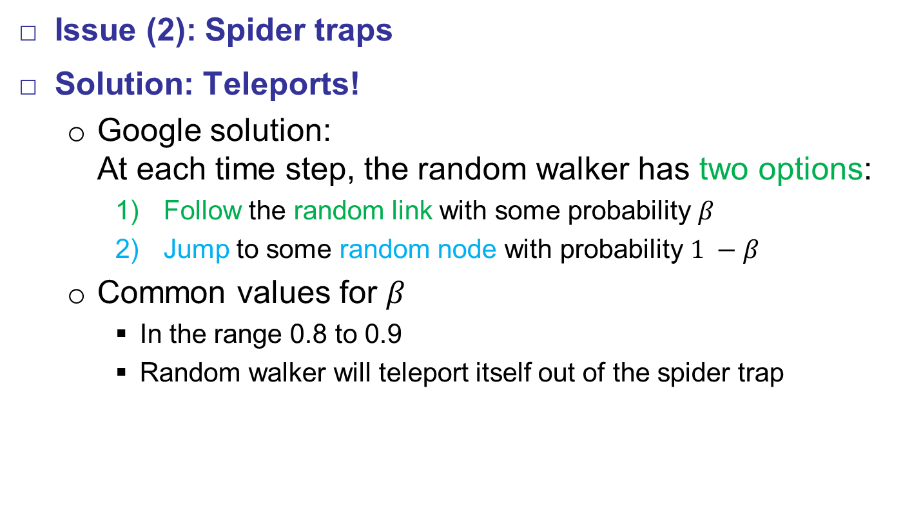


Google Formulation
Issue (2): Spider traps
Solution: Teleports!
  Google solution:
  At each time step, the random walker has two options:
    Follow the random link with some probability $β$
    Jump to some random node with probability $1 −β$
  Common values for $β$
    In the range 0.8 to 0.9
    Random walker will teleport itself out of the spider trap
teleports
A
$$r_{C}/2$$
$$r_{C}/2$$
B
A
$$r_{C}/2$$
$$r_{C}/2$$
B
$$r_{A}$$
C
$$r_{A}$$
C

Slide 39
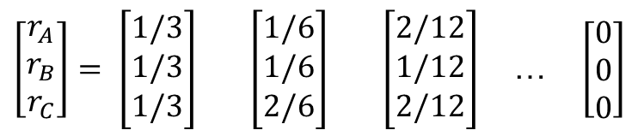

Google Formulation
Issue (1): Dead ends
  Power Iteration
  Results:
$$A$$
$$B$$
$$C$$
B
$$A$$
$$0$$
$$0$$
$$1/2$$
A
$$r_{C}/2$$
$$r_{C}/2$$
$$B$$
$$0$$
$$0$$
$$1/2$$
$$r_{A}$$
$$C$$
$$1$$
$$0$$
$$0$$
C
$$M$$
$\left[\begin{aligned}r_{A} \\ r_{B} \\ r_{C}\end{aligned}\right]= \left[\begin{aligned}1/3 \\ 1/3 \\ 1/3\end{aligned}\right]$ $\left[\begin{aligned}1/6 \\ 1/6 \\ 2/6\end{aligned}\right]$ $\left[\begin{aligned}2/12 \\ 1/12 \\ 2/12\end{aligned}\right]$ … $\left[\begin{aligned}0 \\ 0 \\ 0\end{aligned}\right]$
Iteration
0
1
2
…
B is an dead end, all the importance “leaks out”
since the matrix is not column-stochastic

Slide 40




































Google Formulation
Issue (1): Dead ends
Solution: Teleports!
  Google solution:
  Apply random teleports with the probability 1.0 from each dead end node
teleport
A
$$r_{C}/2$$
$$r_{C}/2$$
B
A
$$r_{C}/2$$
$$r_{C}/2$$
B
$$r_{A}$$
C
$$r_{A}$$
C
$$A$$
$$B$$
$$C$$
$$A$$
$$B$$
$$C$$
$$A$$
$$0$$
$$0$$
$$1/2$$
$$A$$
$$0$$
$$1/3$$
$$1/2$$
$$B$$
$$0$$
$$0$$
$$1/2$$
$$B$$
$$0$$
$$1/3$$
$$1/2$$
$$C$$
$$1$$
$$0$$
$$0$$
$$C$$
$$1$$
$$1/3$$
$$0$$

Slide 41
Google Formulation
Issues Specifics
  Spider traps
    Spider traps are not the problem for the algorithm in a sense that it will still converge
    The algorithm will work, but the rank scores are not what we expect
    Solution: The walker always has the teleporting option, so she will never get stuck in a spider trap
  Dead ends
    Dead ends are a problem for the algorithm
    The assumption was that the matrix is column-stochastic, so with dead ends the initial conditions are not met
    Solution: For each dead end node the walker always follows teleports

Slide 42
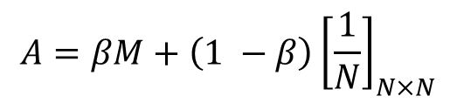
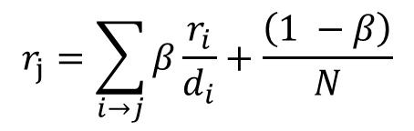
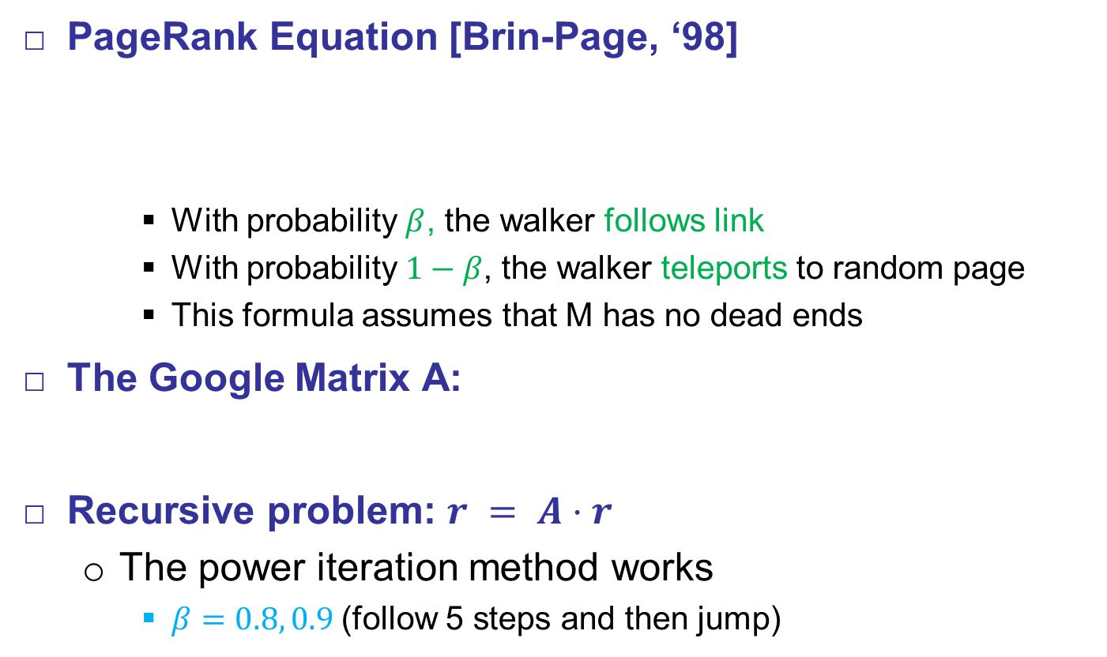
Google Formulation
PageRank Equation [Brin-Page, ‘98]
    With probability $β$, the walker follows link
    With probability $1−β$, the walker teleports to random page
    This formula assumes that M has no dead ends
The Google Matrix A:
Recursive problem: $r = A⋅r$
  The power iteration method works
    $β=0.8, 0.9$(follow 5 steps and then jump)
$$r_{j}=\sum_{i→j}{β\frac{r_{i}}{d_{i}}}+\frac{\left(1 −β\right)}{N}$$
$$A=βM+\left(1 −β\right){\left[\frac{1}{N}\right]}_{N×N}$$

Slide 43











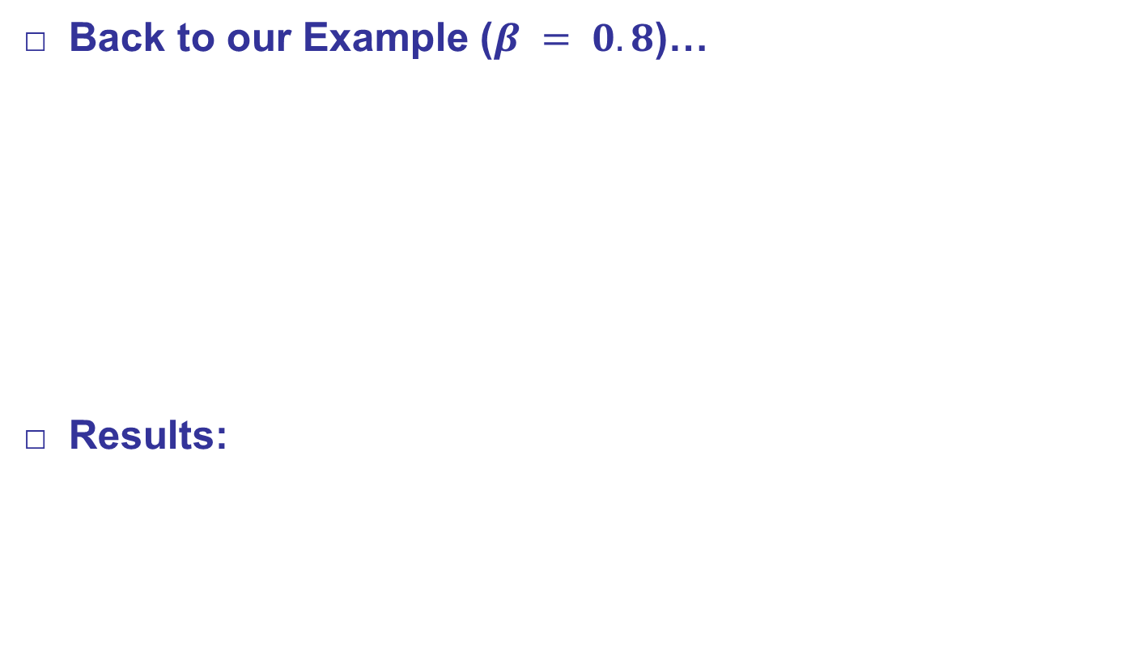










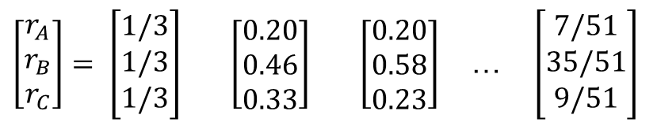


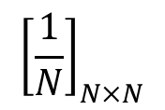






Google Formulation
Back to our Example ($β = 0.8$)…
Results:
1/15
13/15
$$0$$
$$0$$
$$1/2$$
$$1/3$$
$$1/3$$
$$1/3$$
1/15
A
B
$$0.8$$
$$0$$
$$1$$
$$1/2$$
$$+ 0.2$$
$$1/3$$
$$1/3$$
$$1/3$$
1/15
7/15
7/15
$$1$$
$$0$$
$$0$$
$$1/3$$
$$1/3$$
$$1/3$$
13/15
1/15
C
$$M$$
$${\left[\frac{1}{N}\right]}_{N×N}$$
1/15
$$A$$
$$1/15$$
$$1/15$$
$$7/15$$
$$B$$
$$1/15$$
$$13/15$$
$$7/15$$
$$C$$
$$13/15$$
$$1/15$$
$$1/15$$
$$A$$
$\left[\begin{aligned}r_{A} \\ r_{B} \\ r_{C}\end{aligned}\right]= \left[\begin{aligned}1/3 \\ 1/3 \\ 1/3\end{aligned}\right]$ $\left[\begin{aligned}0.20 \\ 0.46 \\ 0.33\end{aligned}\right]$ $\left[\begin{aligned}0.20 \\ 0.58 \\ 0.23\end{aligned}\right]$ … $\left[\begin{aligned}7/51 \\ 35/51 \\ 9/51\end{aligned}\right]$
Iteration
0
1
2
…

Slide 44
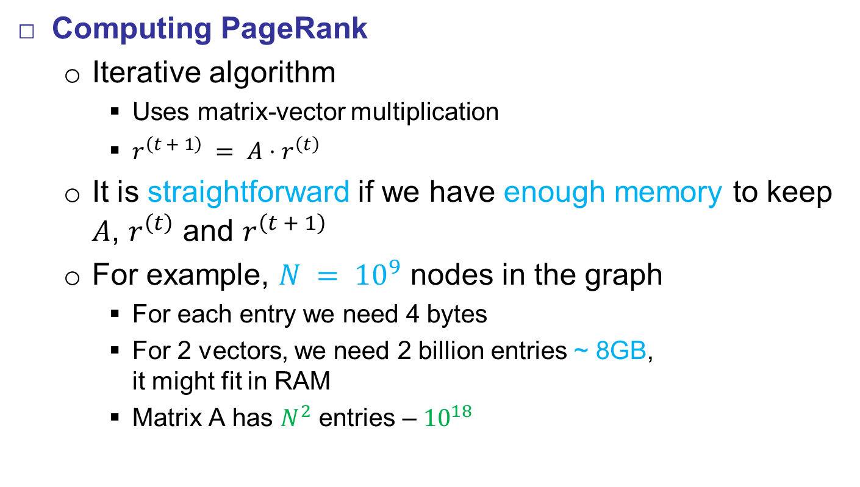
Implementation Details
Computing PageRank
  Iterative algorithm
    Uses matrix-vector multiplication
    $r^{\left(t + 1\right)} = A⋅r^{\left(t\right)}$
  It is straightforward if we have enough memory to keep $A$, $r^{\left(t\right)}$ and $r^{\left(t + 1\right)}$
  For example, $N = {10}^{9}$ nodes in the graph
    For each entry we need 4 bytes
    For 2 vectors, we need 2 billion entries ~ 8GB,
    it might fit in RAM
    Matrix A has $N^{2}$ entries – ${10}^{18}$

Slide 45
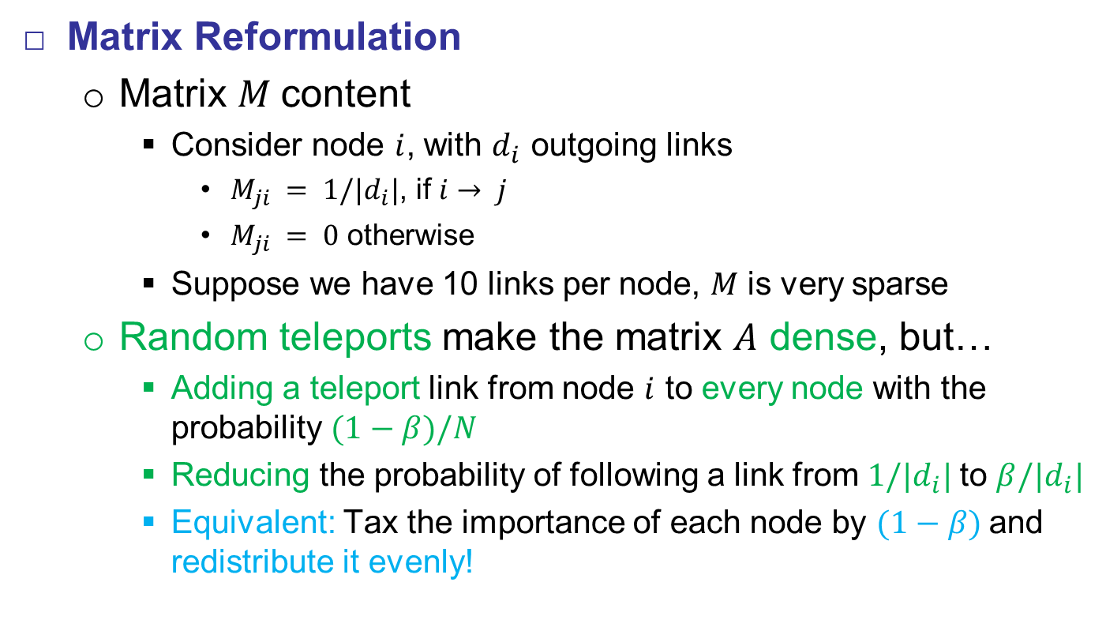
Implementation Details
Matrix Reformulation
  Matrix $M$content
    Consider node $i$, with $d_{i}$ outgoing links
      $M_{ji} = 1/|d_{i}|$, if $i→ j$
      $M_{ji} = 0$ otherwise
    Suppose we have 10 links per node, $M$ is very sparse
  Random teleports make the matrix $A$ dense, but…
    Adding a teleport link from node $i$ to every node with the probability $(1−β)/N$
    Reducing the probability of following a link from $1/|d_{i}|$to $β/|d_{i}|$
    Equivalent: Tax the importance of each node by $(1−β)$and redistribute it evenly!

Slide 46
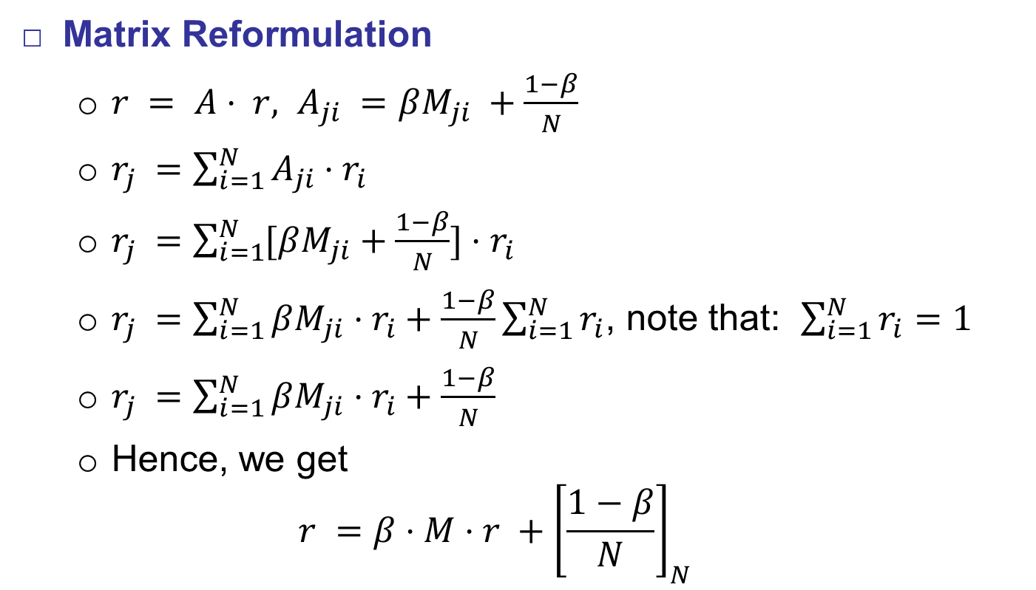
Implementation Details
Matrix Reformulation
  $r = A⋅ r, A_{ji} =βM_{ji} +\frac{1−β}{N}$
  $r_{j} =\sum_{i=1}^{N}{A_{ji}⋅r_{i}}$
  $r_{j} =\sum_{i=1}^{N}{[βM_{ji}+\frac{1−β}{N}]⋅r_{i}}$
  $r_{j} =\sum_{i=1}^{N}{βM_{ji}⋅r_{i}+\frac{1−β}{N}\sum_{i=1}^{N}{r_{i}}}$, note that: $\sum_{i=1}^{N}{r_{i}}=1$
  $r_{j} =\sum_{i=1}^{N}{βM_{ji}⋅r_{i}+\frac{1−β}{N}}$
  Hence, we get
  $$r =β⋅M⋅r +{\left[\frac{1−β}{N}\right]}_{N}$$
We assume that M
has no dead ends

Slide 47
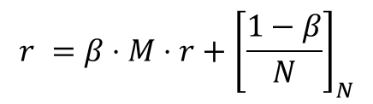
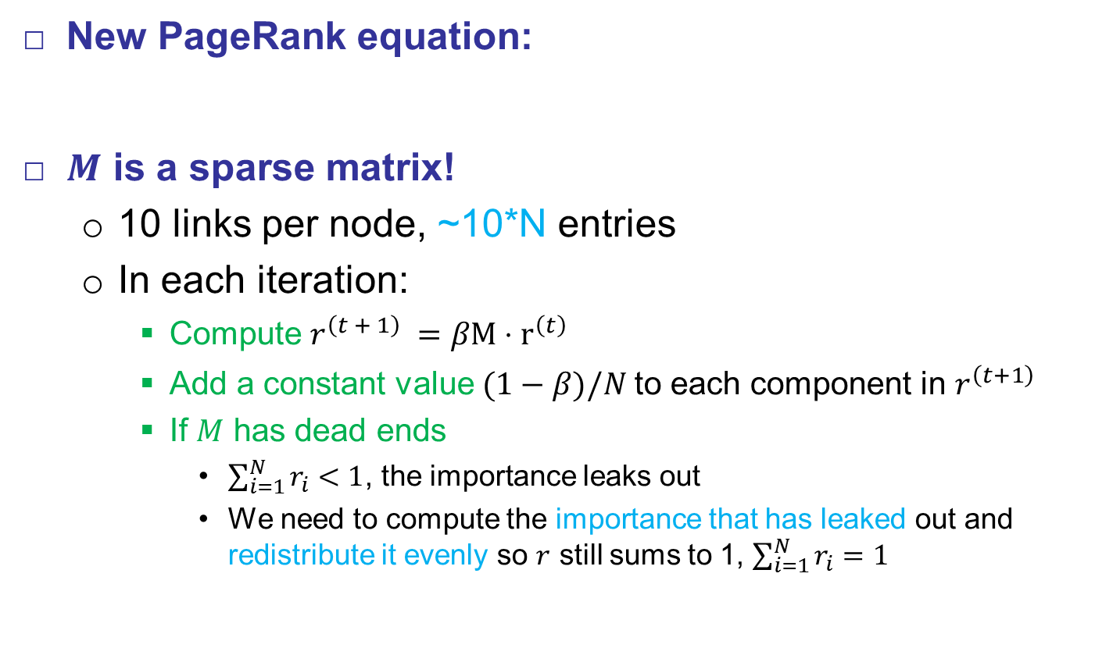
Implementation Details
New PageRank equation:
$M$ is a sparse matrix!
  10 links per node, ~10*N entries
  In each iteration:
    Compute $r^{\left(t + 1\right)} =βM⋅r^{\left(t\right)}$
    Add a constant value $(1−β)/N$to each component in $r^{\left(t+1\right)}$
    If $M$ has dead ends
      $\sum_{i=1}^{N}{r_{i}}<1$, the importance leaks out
      We need to compute the importance that has leaked out and redistribute it evenly so $r$ still sums to 1, $\sum_{i=1}^{N}{r_{i}}=1$
$$r =β⋅M⋅r+{\left[\frac{1−β}{N}\right]}_{N}$$

Slide 48

Implementation Details
PageRank Algorithm
    Input: Graph $G$ (with spider traps and dead ends), $β$
    Output: PageRank vector $r$
    $$r_{j}^{\left(t\right)}≔1/N$$
    do
    $S := 0$ //accumulator for non-leaked importance
    for $j := 1$ to $N$
    ${r′}_{j}^{\left(t+1\right)}= \sum_{i→j}{β(\frac{r_{i}^{\left(t\right)}}{d_{i}})}$
    ${S+=r′}_{j}^{\left(t+1\right)}$
    for $j := 1$ to $N$ // re-insert the leaked importance
    ${r′}_{j}^{\left(t+1\right)}+=(1 −S)/N$
    while ($\sum_{j}{\left|{r^{′}}_{j}^{\left(t+1\right)}−r_{j}^{\left(t\right)}\right|>ε}$ )

Slide 49

Implementation Details
Data Structures
  Use adjacency list for graph/matrix representation
    Encode it using nonzero entries
    It requires space proportional to the number of links
    Lets assume web graph
      $N = {10}^{9}$, 1 billion nodes
      Space ~ $10⋅ N = 4⋅ 10⋅ {10}^{9} = 40$ GB
      It will not fit in main memory, but it can fit on disk
Source node | Node Degree | Destination nodes
0 | 2 | 1, 4
1 | 6 | 0, 3, 5, 12, 98, 314
… | … | …
N | 5 | 18, 2, 3, 8, 10

Slide 50

Implementation Details
PageRank Algorithm
Hard Cases
  Case (1):
    Assume $M$ cannot fit in memory
    Assume $r^{\left(t + 1\right)}$can fit in RAM
  Case (2):
    Assume $M$ cannot fit in memory
    Assume even $r^{\left(t + 1\right)}$ cannot fit in RAM

Slide 51




Implementation Details
Case (1)
    We assume $M$ cannot fit in memory and $r^{\left(t + 1\right)}$can fit in RAM
    1 step of iteration *$M$ and $r^{\left(t\right)}$ stored on disk*:
$$r^{\left(t + 1\right)} := (1−β)/N$$
for each node $i$ with out degree $d_{i}$
read in memory: $i, d_{i}, dest_{1}, dest_{2}, …, dest_{d_{i}}, r^{\left(t\right)}[i]$
for $j := 1$to $d_{i}$
$r^{\left(t + 1\right)}[dest_{j}] +=β r^{\left(t\right)}[i]/d_{i}$
$$r^{\left(t+1\right)}$$
$$r^{\left(t\right)}$$
0
Source | Degree | Destination
0 | 2 | 1, 4
1 | 3 | 0, 2, 5
2 | 5 | 18, 2, 3, 8, 10
0
1
1
2
2
3
3
4
4

Slide 52
Implementation Details
Case (1)
    We assume $M$ cannot fit in memory and $r^{\left(t + 1\right)}$can fit in RAM
    1 step of iteration *$M$ and $r^{\left(t\right)}$ stored on disk*:
$$r^{\left(t + 1\right)} := (1−β)/N$$
for each node $i$ with out degree $d_{i}$
read in memory: $i, d_{i}, dest_{1}, dest_{2}, …, dest_{d_{i}}, r^{\left(t\right)}[i]$
for $j := 1$to $d_{i}$
$r^{\left(t + 1\right)}[dest_{j}] +=β r^{\left(t\right)}[i]/d_{i}$
$$r^{\left(t+1\right)}$$
$$r^{\left(t\right)}$$
0
Source | Degree | Destination
0 | 2 | 1, 4
1 | 3 | 0, 2, 3
2 | 5 | 18, 2, 3, 8, 10
0
1
1
2
2
3
3
4
4

Slide 53

Implementation Details
Case (1)
  Computational Analysis
    Store $r^{\left(t\right)}$and matrix $M$ on disk
    In each iteration:
      Read $r^{\left(t\right)}$
      Write $r^{\left(t + 1\right)}$
    Hence, cost per iteration
      $2|r| +|M|$
  What should we do in Case (2)?
    $r^{\left(t + 1\right)}$cannot fit in RAM

Slide 54



Implementation Details
Case (2)
    We assume neither $M$ nor $r^{\left(t + 1\right)}$can fit in RAM
    Solution: we split vector $r^{\left(t + 1\right)}$ into $k$ blocks that do fit in RAM
$$r^{\left(t+1\right)}$$
$$r^{\left(t\right)}$$
0
Source | Degree | Destination
0 | 2 | 1, 4
1 | 3 | 0, 2, 3
2 | 5 | 18, 21, 9, 8, 10
0
1
1
2
3
2
4
3
4

Slide 55
Implementation Details
Case (2)
    We assume neither $M$ nor $r^{\left(t + 1\right)}$can fit in RAM
    Solution: we split vector $r^{\left(t + 1\right)}$ into $k$ blocks that do fit in RAM
$$r^{\left(t+1\right)}$$
$$r^{\left(t\right)}$$
0
Source | Degree | Destination
0 | 2 | 1, 4
1 | 3 | 0, 2, 3
2 | 5 | 18, 21, 9, 8, 10
0
1
1
2
3
2
4
3
4

Slide 56
Implementation Details
Case (2)
    We assume neither $M$ nor $r^{\left(t + 1\right)}$can fit in RAM
    Solution: we split vector $r^{\left(t + 1\right)}$ into $k$ blocks that do fit in RAM
$$r^{\left(t+1\right)}$$
$$r^{\left(t\right)}$$
0
Source | Degree | Destination
0 | 2 | 1, 4
1 | 3 | 0, 2, 3
2 | 5 | 18, 21, 9, 8, 10
0
1
1
2
3
2
4
3
4

Slide 57
Implementation Details
Case (2)
    We assume neither $M$ nor $r^{\left(t + 1\right)}$can fit in RAM
    Solution: we split vector $r^{\left(t + 1\right)}$ into $k$ blocks that do fit in RAM
$$r^{\left(t+1\right)}$$
$$r^{\left(t\right)}$$
0
Source | Degree | Destination
0 | 2 | 1, 4
1 | 3 | 0, 2, 3
2 | 5 | 18, 21, 9, 8, 10
0
1
1
2
3
2
4
3
4

Slide 58

Implementation Details
Case (2)
  Computational Analysis
    We assume neither $M$ nor $r^{\left(t + 1\right)}$can fit in RAM
    Solution: we split vector $r^{\left(t + 1\right)}$ into $k$ blocks that do fit in RAM
    Scan $M$ and $r^{\left(t\right)}$ once for each block $k_{i}$
  Cost per iteration
    $k(|M| +|r|)$
    $M$ is larger than $r$, $\sim \left(10−20\right)×$larger
    Can we do better?

Slide 59



Implementation Details
Case (2) – Can we do better?
    We assume neither $M$ nor $r^{\left(t + 1\right)}$can fit in RAM
      (A) Split vector $r^{\left(t + 1\right)}$ into $k$ blocks that do fit in RAM
      (B) Break $M$into $k$ stripes so each stripe contains only destinations that are in the corresponding block of $r^{\left(t + 1\right)}$
$$r^{\left(t+1\right)}$$
$$r^{\left(t\right)}$$
0
Source | Degree | Destination
0 | 4 | 0, 1, 3, 4
1 | 2 | 0, 4
2 | 3 | 1, 2, 5
0
1
1
2
2
3
3
4
5
4
5

Slide 60
Implementation Details
Case (2) – Can we do better?
    We assume neither $M$ nor $r^{\left(t + 1\right)}$can fit in RAM
      (A) Split vector $r^{\left(t + 1\right)}$ into $k$ blocks that do fit in RAM
      (B) Break $M$into $k$ stripes so each stripe contains only destinations that are in the corresponding block of $r^{\left(t + 1\right)}$
Source | Degree | Destination
$$r^{\left(t+1\right)}$$
$$r^{\left(t\right)}$$
0 | 4 | 0, 1
1 | 2 | 0
2 | 3 | 1
0
0
1
1
2
2
3
3
4
5
4
5

Slide 61
Implementation Details
Case (2) – Can we do better?
    We assume neither $M$ nor $r^{\left(t + 1\right)}$can fit in RAM
      (A) Split vector $r^{\left(t + 1\right)}$ into $k$ blocks that do fit in RAM
      (B) Break $M$into $k$ stripes so each stripe contains only destinations that are in the corresponding block of $r^{\left(t + 1\right)}$
$$r^{\left(t+1\right)}$$
$$r^{\left(t\right)}$$
0
Source | Degree | Destination
0 | 4 | 0, 1, 3, 4
1 | 2 | 0, 4
2 | 3 | 1, 2, 5
0
1
1
2
2
3
3
4
5
4
5

Slide 62
Implementation Details
Case (2) – Can we do better?
    We assume neither $M$ nor $r^{\left(t + 1\right)}$can fit in RAM
      (A) Split vector $r^{\left(t + 1\right)}$ into $k$ blocks that do fit in RAM
      (B) Break $M$into $k$ stripes so each stripe contains only destinations that are in the corresponding block of $r^{\left(t + 1\right)}$
Source | Degree | Destination
$$r^{\left(t+1\right)}$$
$$r^{\left(t\right)}$$
0 | 4 | 0, 1
1 | 2 | 0
2 | 3 | 1
0
0
1
1
2
2
0 | 4 | 3
2 | 3 | 2
3
3
4
5
4
5

Slide 63
Implementation Details
Case (2) – Can we do better?
    We assume neither $M$ nor $r^{\left(t + 1\right)}$can fit in RAM
      (A) Split vector $r^{\left(t + 1\right)}$ into $k$ blocks that do fit in RAM
      (B) Break $M$into $k$ stripes so each stripe contains only destinations that are in the corresponding block of $r^{\left(t + 1\right)}$
$$r^{\left(t+1\right)}$$
$$r^{\left(t\right)}$$
0
Source | Degree | Destination
0 | 4 | 0, 1, 3, 4
1 | 2 | 0, 4
2 | 3 | 1, 2, 5
0
1
1
2
2
3
3
4
5
4
5

Slide 64
Implementation Details
Case (2) – Can we do better?
    We assume neither $M$ nor $r^{\left(t + 1\right)}$can fit in RAM
      (A) Split vector $r^{\left(t + 1\right)}$ into $k$ blocks that do fit in RAM
      (B) Break $M$into $k$ stripes so each stripe contains only destinations that are in the corresponding block of $r^{\left(t + 1\right)}$
Source | Degree | Destination
$$r^{\left(t+1\right)}$$
$$r^{\left(t\right)}$$
0 | 4 | 0, 1
1 | 2 | 0
2 | 3 | 1
0
0
1
1
2
2
0 | 4 | 3
2 | 3 | 2
3
3
4
5
0 | 4 | 4
1 | 2 | 4
2 | 3 | 5
4
5

Slide 65

Implementation Details
Case (2) – Better Approach
  Computational Analysis
    We assume neither $M$ nor $r^{\left(t + 1\right)}$can fit in RAM
      (A) Split vector $r^{\left(t + 1\right)}$ into $k$ blocks that do fit in RAM
      (B) Break $M$into $k$ stripes so each stripe contains only destinations that are in the corresponding block of $r^{\left(t + 1\right)}$
  Cost per iteration
    Some additional overhead per stripe
    $\left|M\right|(1+ε)+ k|r|$

Slide 66
PageRank Issues
PageRank Issues
  It measures general popularity of the node
    Some topics may not be so popular
    Solution: topic-specific PageRank algorithm
  It uses a single measure of importance
    There are other models of importance
    Solution: Hubs and Authorities
  Vulnerable to Link spam
    One could create artificial structure of nodes in order to boost the importance of particular node
    Solution: TrustRank

